Slide 1
Title Slide – Capes for Kids
JOIN FORCES WITH US!

Slide 2
Virtual Trivia Night Instructions
Virtual Trivia Night!
Below are all the materials you will need to host your very own Virtual Trivia Night with your friends and family…
Click here to access the How to Guide for hosting your own Virtual Trivia Night.
Click here to access the host answer key.
Click here to access the participation sheet. (Tip: You should download this sheet and send it to all your friends and family in advance for them to print out!)
Click here to print the Winner’s Certificate!
Click here for our Kahoot version of the trivia game.
You are now ready to host! Open whatever virtual platform you are using to host your night and share your screen with this PDF or the Kahoot game. Don’t forget to wear your cape and have fun!

Slide 3
Round 1: Name that Superhero
Round 1: Name that Superhero
Get ready to use the hint in the questions to figure out who the superhero is!

Slide 4
Who is the superhero that is also known as the “Man of Steel?”
Who is the superhero that is also known as the “Man of Steel?”
A. Superman
B. The Flash
C. Captain America
D. BatMan

Slide 5
Who is the superhero twin brother of Scarlet Witch?
Who is the superhero twin brother of Scarlet Witch?
A. WOlverine
B. Quicksilver
C. The Flash
D. Loki

Slide 6
Which superhero has a magic lasso and bullet-proof bracelets?
Which superhero has a magic lasso and bullet-proof bracelets?
A. Electra
B. SuperGirl
C. Wonder woman
B. Black Widow

Slide 7
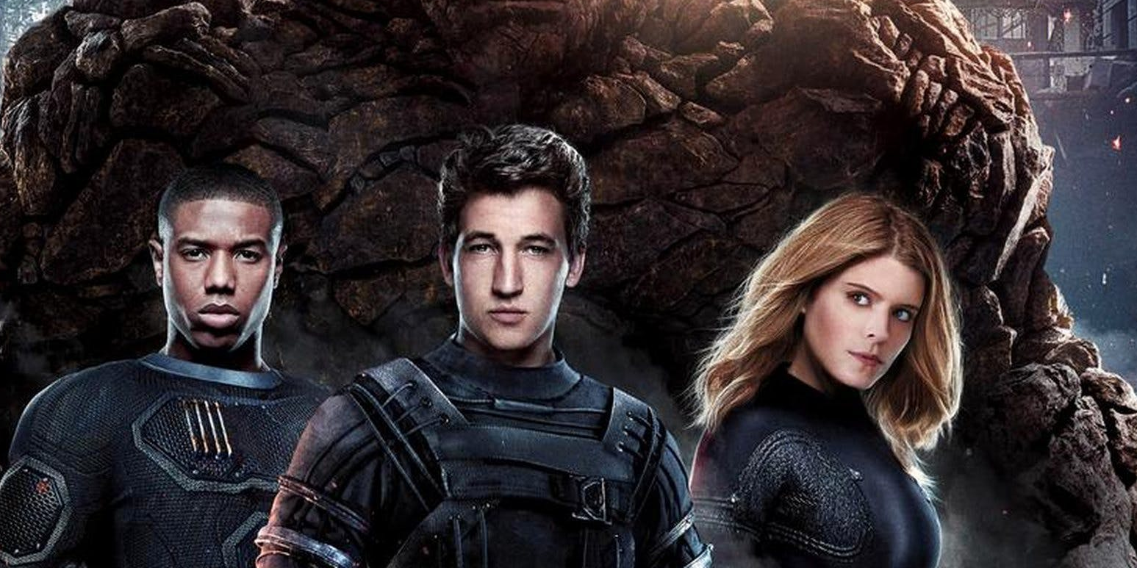
Who is the superhero who can no longer transform back into human form anymore?
Who is the superhero who can no longer transform back into human form anymore?
A. Spiderman
B. Sandman
C. The Thing
D. Hulk

Slide 8
Who is the superhero who can manipulate and resist the weather?
Who is the superhero who can manipulate and resist the weather?
A. Bat Girl
B. Storm
C. Captain Marvel
D. Electra

Slide 9
Which superhero is a neurosurgeon?
Which superhero is a neurosurgeon?
A. Captain MArvel
B. Dr. Otto Octavius
C. Captain America
D. Dr. Strange

Slide 10
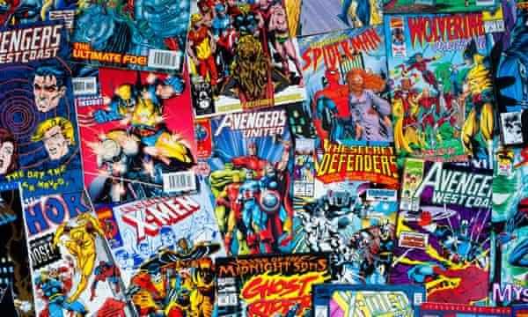
Who was the first Costumed superhero ever?
Who was the first Costumed superhero ever?
A. SuperMan
B. Spiderman
C. Hulk
D. The Phantom

Slide 11
Who was the first female superhero to appear in the title of an MCU film?
Who was the first female superhero to appear in the title of an MCU film?
A. Wonder Woman
B. Bat Girl
C. Wasp
D. Captain Marvel

Slide 12
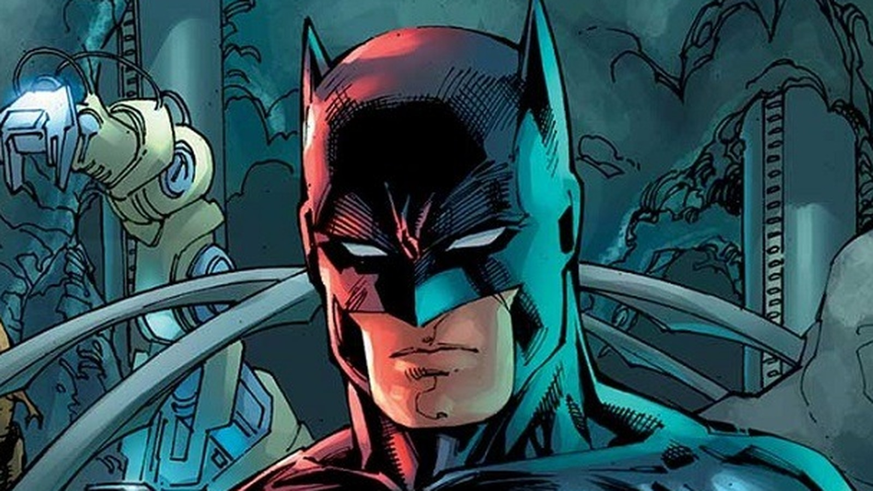
What is the real name of Batman?
What is the real name of Batman?
A. Bruce Willis
B. Clark Kent
C. TOm Holland
D. Bruce Wayne

Slide 13
The “Scarlet Speedster” is the nickname of which superhero?
The “Scarlet Speedster” is the nickname of which superhero?
A. Captain America
B. QuickSilver
C. THe Flash
D. Thor

Slide 14
Round 2: Marvel TRivia
Round 2: Marvel TRivia
Get ready to find out if you really are a true, Marvel fan!

Slide 15
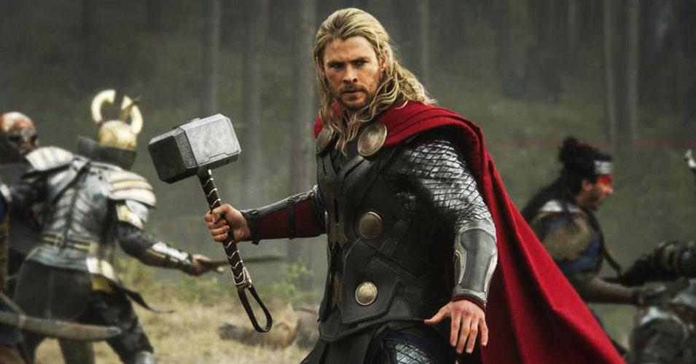
What is the name of Thor’s hammer?
What is the name of Thor’s hammer?
A. MJOLNIR
B. JONATHAN
C. MILNAJWAR
D. THOR’S HAMMER

Slide 16
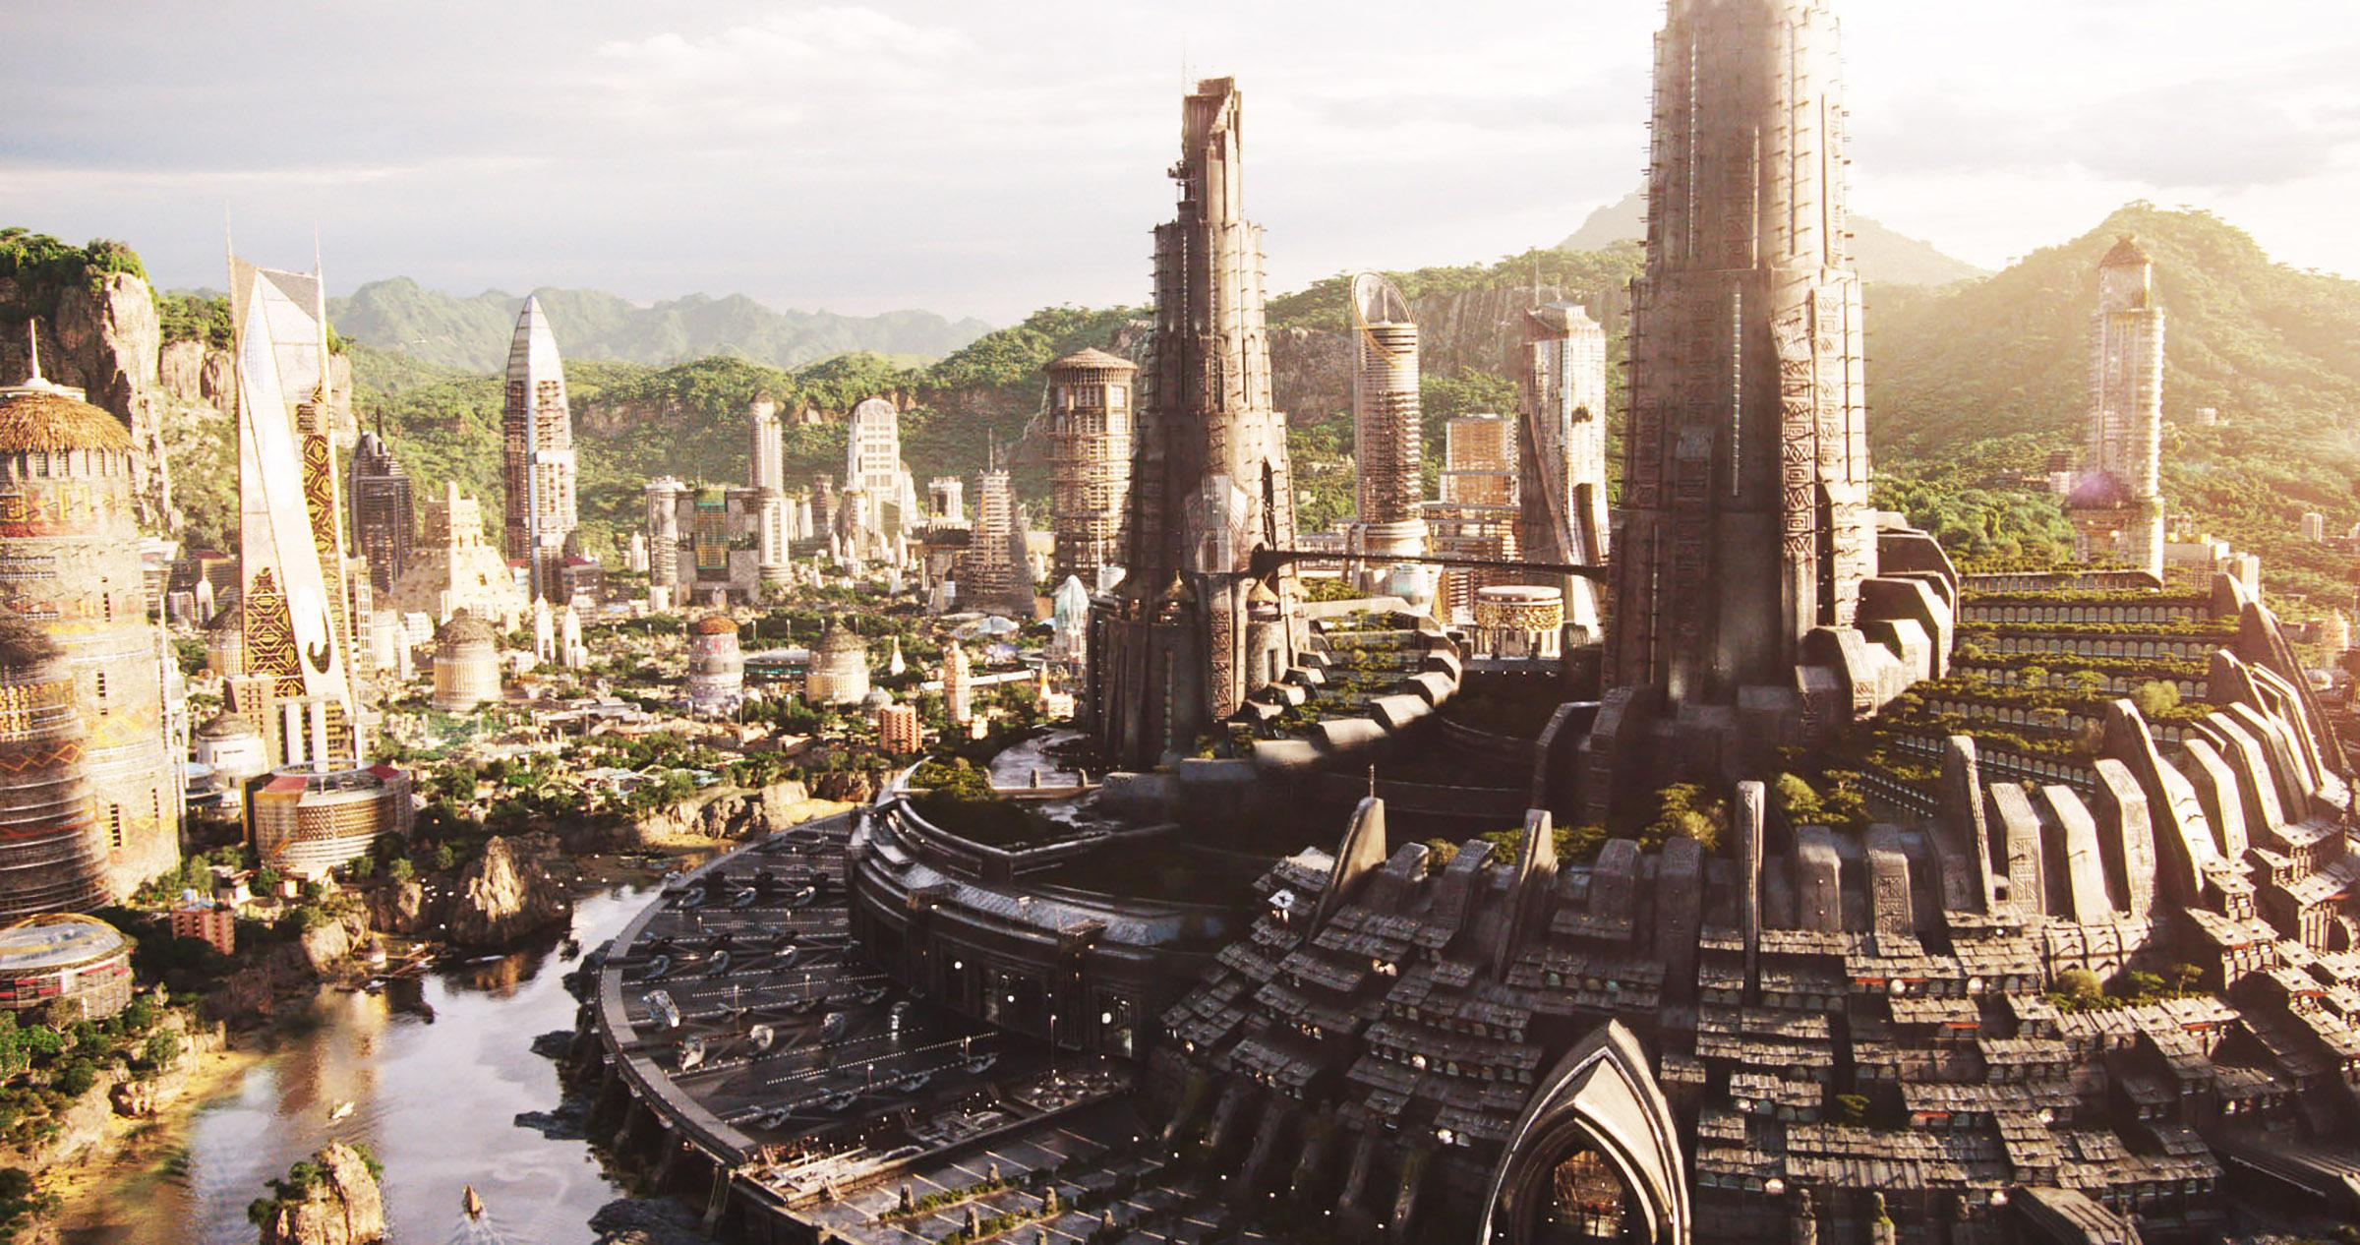
What kingdom does the Black Panther rule?
What kingdom does the Black Panther rule?
A. Sokovia
B. ASgard
C. Hell’s Kitchen, New York
D. WAKANDA

Slide 17
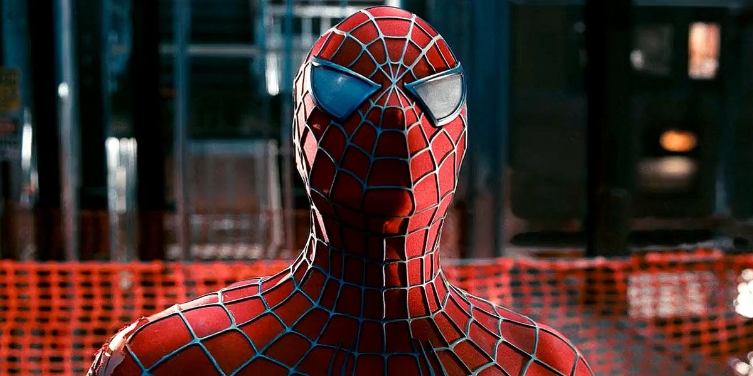
How did Spider-man get his superpowers?
How did Spider-man get his superpowers?
A. Bitten by a Shark
B. Exposed to Radioactive Waste
C. Born With IT
D. Bitten by A Radioactive Spider

Slide 18
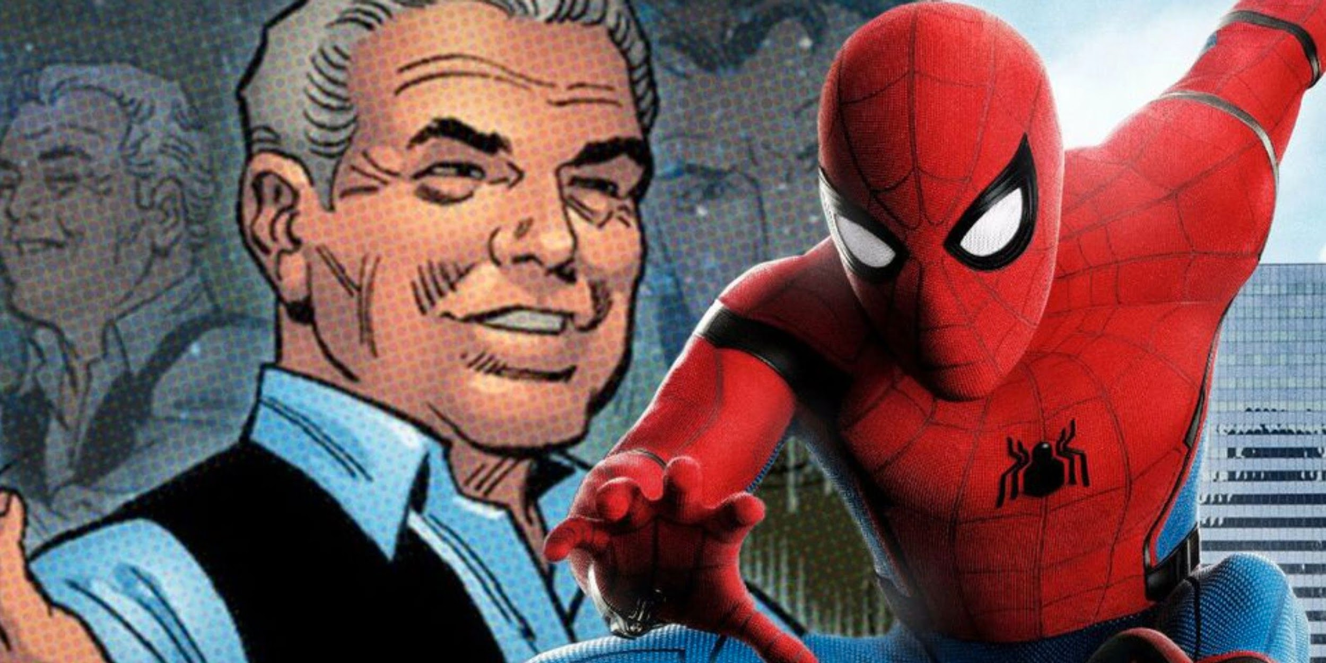
In the Spider-man movie, Uncle Ben said something to Peter. Fill in the blanks: “With great power, comes great __”
In the Spider-man movie, Uncle Ben said something to Peter. Fill in the blanks: “With great power, comes great __”
A. Hope
B. Accountability
C. Control
D. Responsibility

Slide 19
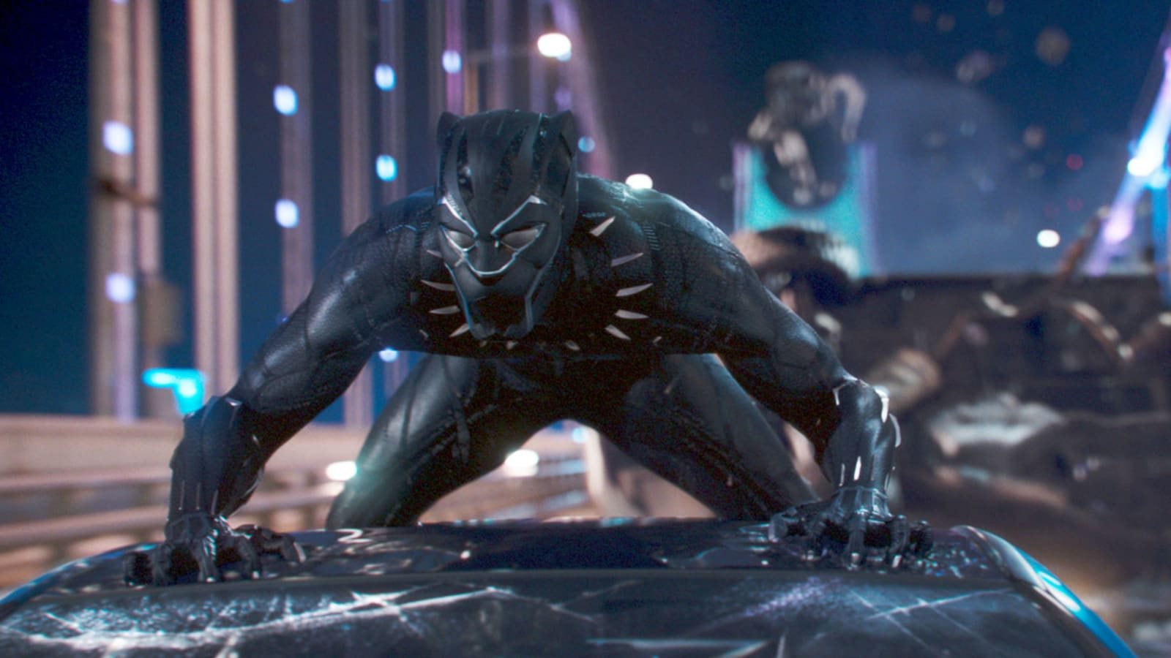
What herb grants the Black Panther his powers?
What herb grants the Black Panther his powers?
A. Star-Shaped Herb
B. Flower-Shaped Herb
C. Heart-Shaped Herb
D. Moon-Shaped Herb

Slide 20
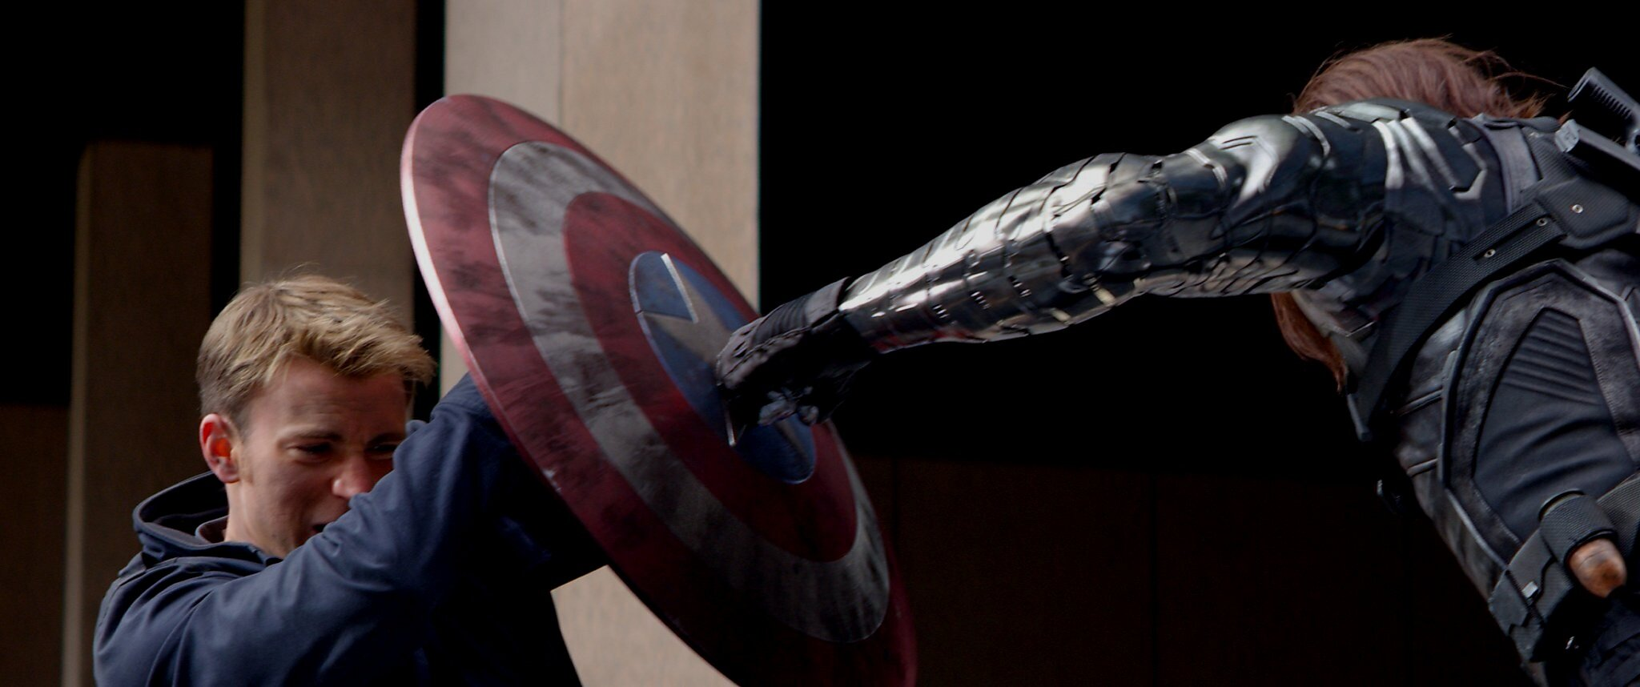
Captain America’s shield and Bucky’s arm are made of what?
Captain America’s shield and Bucky’s arm are made of what?
A. Iron
B. Vibranium
C. Steel
D. Germanium

Slide 21
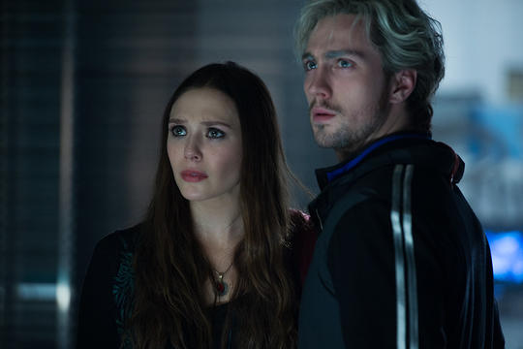
Wanda and her brother Pietro are from where?
Wanda and her brother Pietro are from where?
A. Wakanda
B. Asgard
C. Sokovia
D. New York

Slide 22
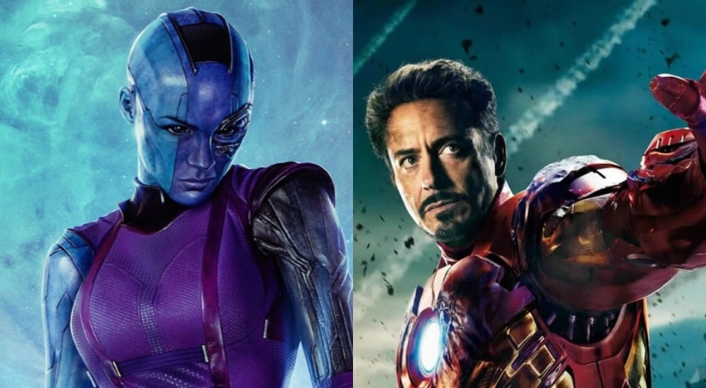
Who rescued Tony Stark and Nebula from space?
Who rescued Tony Stark and Nebula from space?
A. SuperMan
B. Captain Marvel
C. Spiderman
D. THor

Slide 23
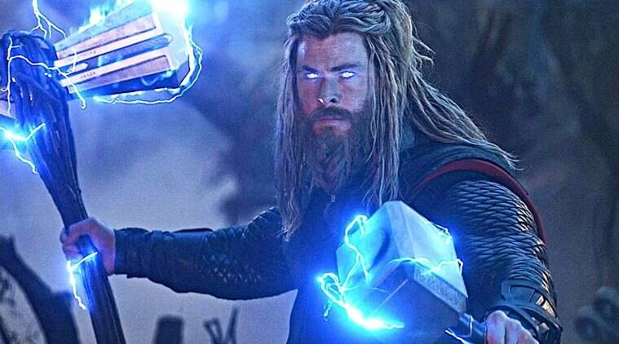
Thor played what video game in Avengers: Endgame?
Thor played what video game in Avengers: Endgame?
A. Minecraft
B. Fortnite
C. League of Legends
D. Roblox

Slide 24
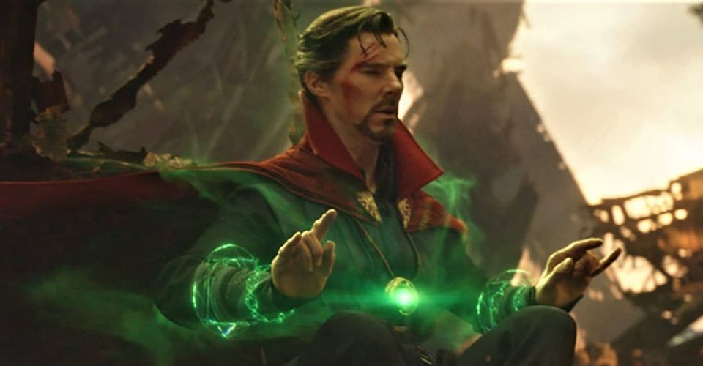
What’s the name of the amulet Doctor Strange wears around his neck?
What’s the name of the amulet Doctor Strange wears around his neck?
A. Eye of ASgard
B. Eye of The Time Stone
C. Eye of the Mind Stone
D. Eye of Agamotto

Slide 25
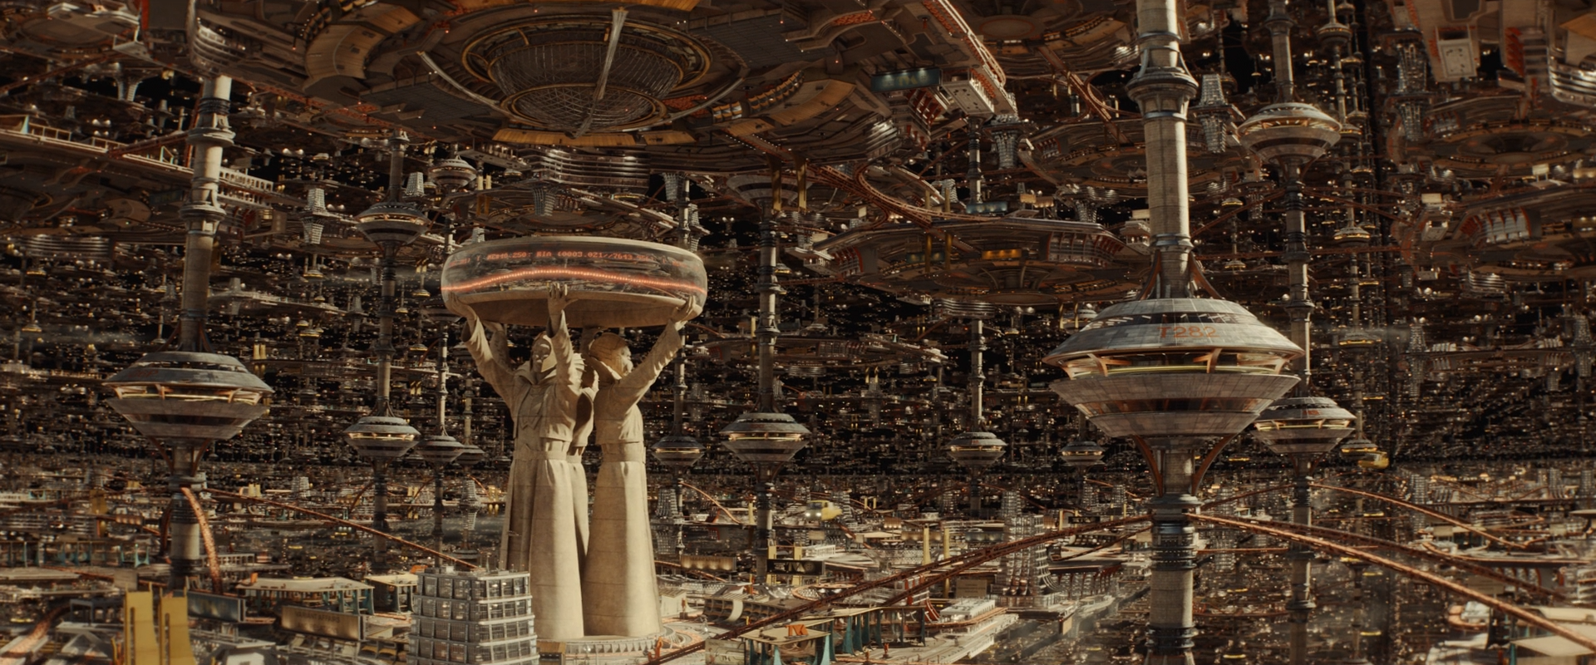
What does TVA stand for?
What does TVA stand for?
A. TIme Variance Administration
B. Time Variation Authority
C. Time Variety Authority
D. Time Variance Authority

Slide 26
Round 3: DC TRivia
Round 3: DC TRivia
Get ready to find out if you really are a true, DC fan!

Slide 27
Who is the only superhero that was a member of both the Justice League and the Avengers?
Who is the only superhero that was a member of both the Justice League and the Avengers?
A. Hawkeye
B. Green Arrow
C. Daredevil
D. Superwoman

Slide 28
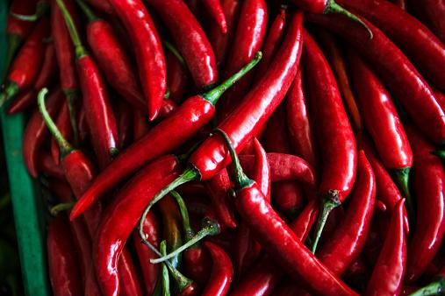
What is the spiciest food in the DC Universe?
What is the spiciest food in the DC Universe?
A. Green Arrow’s Chili
B. Daredevil’s Ghost Peppers
C. Yelena’s Sriracha
D. Scarlet Witch’s Chili Corn Flakes

Slide 29
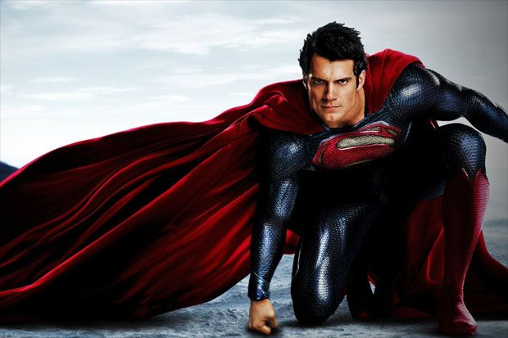
What is Superman's dad's name?
What is Superman's dad's name?
A. John-El
B. Jor-El
C. Zam-El
D. Zor-El

Slide 30
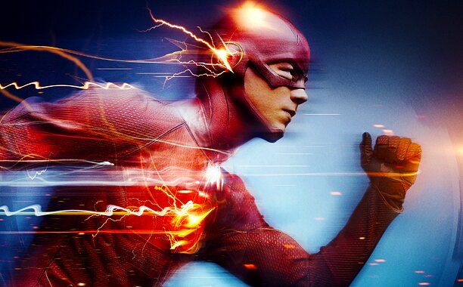
How did the original Flash get his powers?
How did the original Flash get his powers?
A. Struck by Lightning
B. Bitten by a Spider
C. Born with It
D. Inhaled Nuclear Fumes

Slide 31
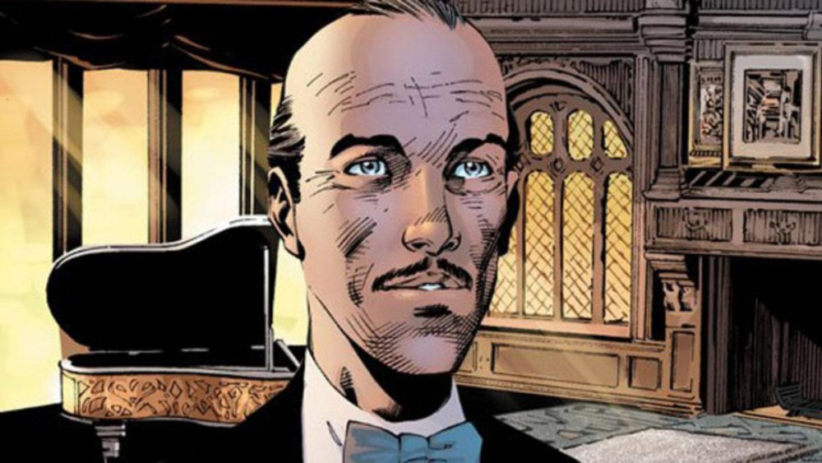
What is the name of Batman's butler?
What is the name of Batman's butler?
A. Alfred PennyWorth
B. Albert Pennyworth
C. Alfred PennyWatch
D. ALbert Wayne

Slide 32
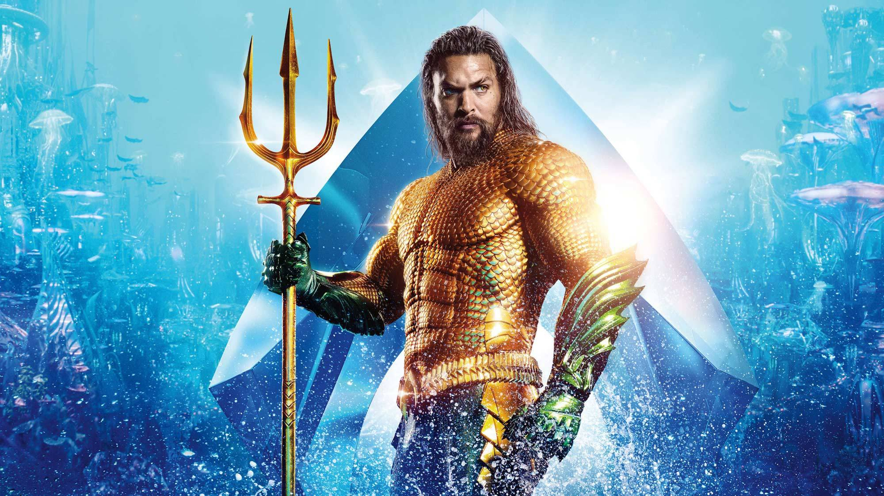
What is Aquaman's real name?
What is Aquaman's real name?
A. Arthur Curry
B. Clark Kent
C. Hal Jordan
D. Barry Allen

Slide 33
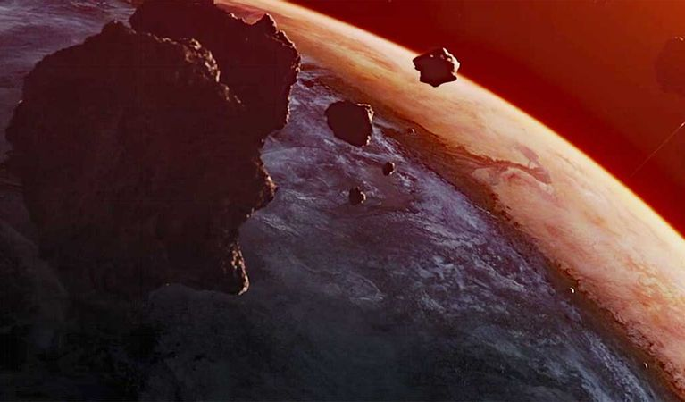
Where is Superman's home?
Where is Superman's home?
A. Asgard
B. Krypton
C. Xandar
D. MidGard

Slide 34
What is Wonder Woman's whip called?
What is Wonder Woman's whip called?
A. The Whip of Candor
B. The Lasso of Verity
C. The Lasso of Truth
D. The Whip of Accuracy

Slide 35
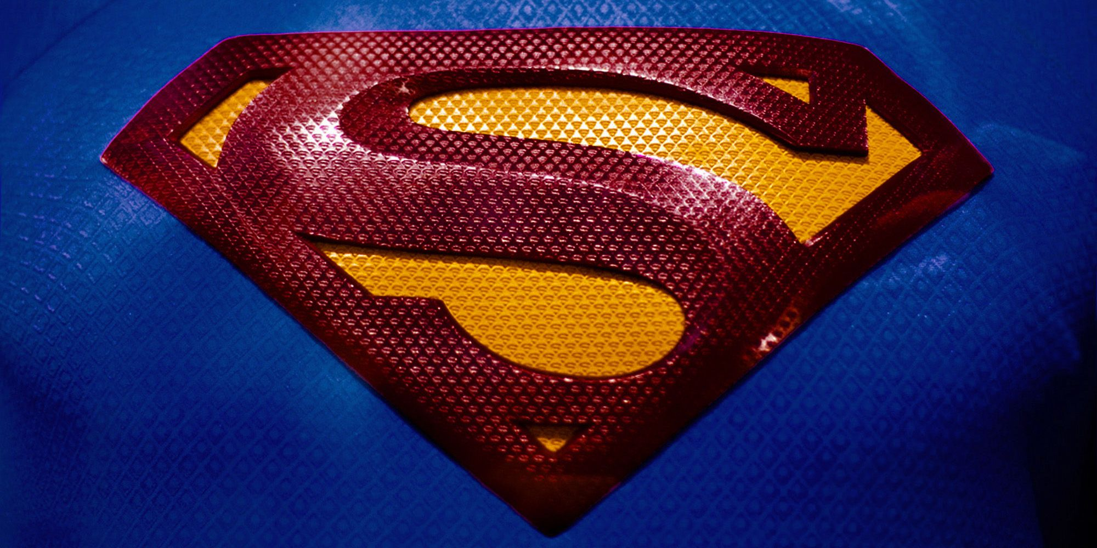
What is the Superman logo a Kryptonian symbol for?
What is the Superman logo a Kryptonian symbol for?
A. Truth
B. Hope
C. Love
D. Dream

Slide 36
What does 'DC' stand for?
What does 'DC' stand for?
A. Detective Comics
B. Dagger Comics
C. Devious Comics
D. Dynamic COmics

Slide 37
Round 4: Figure out Who that Superhero Is!
Round 4: Figure out Who that Superhero Is!
Get ready to use the images to find out who the superhero is!

Slide 38
Figure out Who that Superhero Is!

Slide 39
Figure out Who that Superhero Is!

Slide 40
Figure out Who that Superhero Is!

Slide 41
Figure out Who that Superhero Is!

Slide 42
Figure out Who that Superhero Is!

Slide 43
Figure out Who that Superhero Is!

Slide 44
Figure out Who that Superhero Is!

Slide 45
Figure out Who that Superhero Is!

Slide 46
Figure out Who that Superhero Is!

Slide 47
Figure out Who that Superhero Is!

Slide 48
Round 5: Cartoon TRivia!
Round 5: Cartoon TRivia!
Enjoy some fun, cartoon trivia to finish off your trivia night!

Slide 49
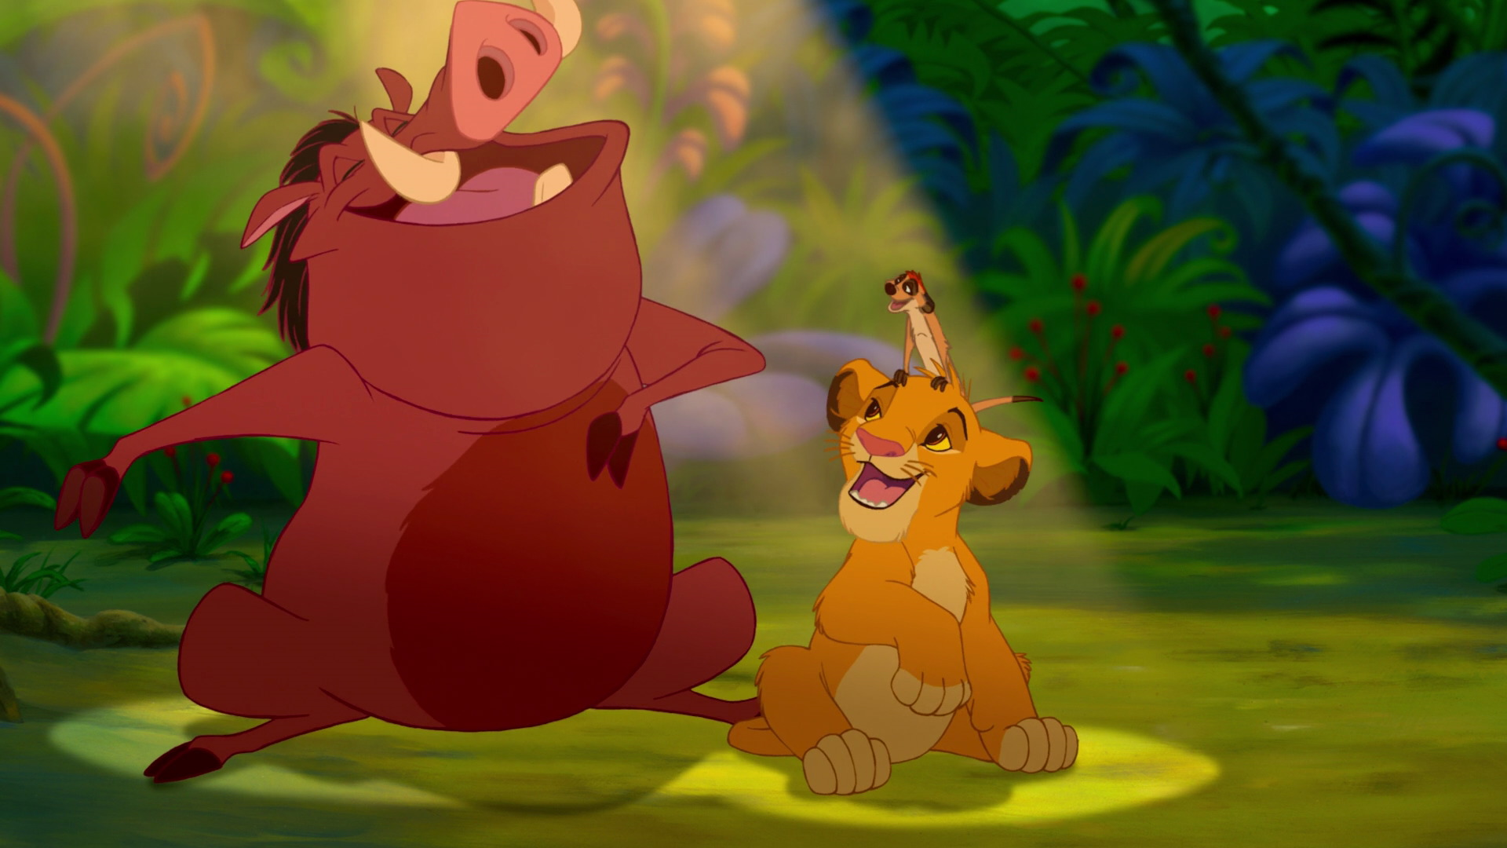
What does Hakuna Matata mean?
What does Hakuna Matata mean?
A. It will be okay
B. No Worries
C. Love Everyone
D. have Fun

Slide 50
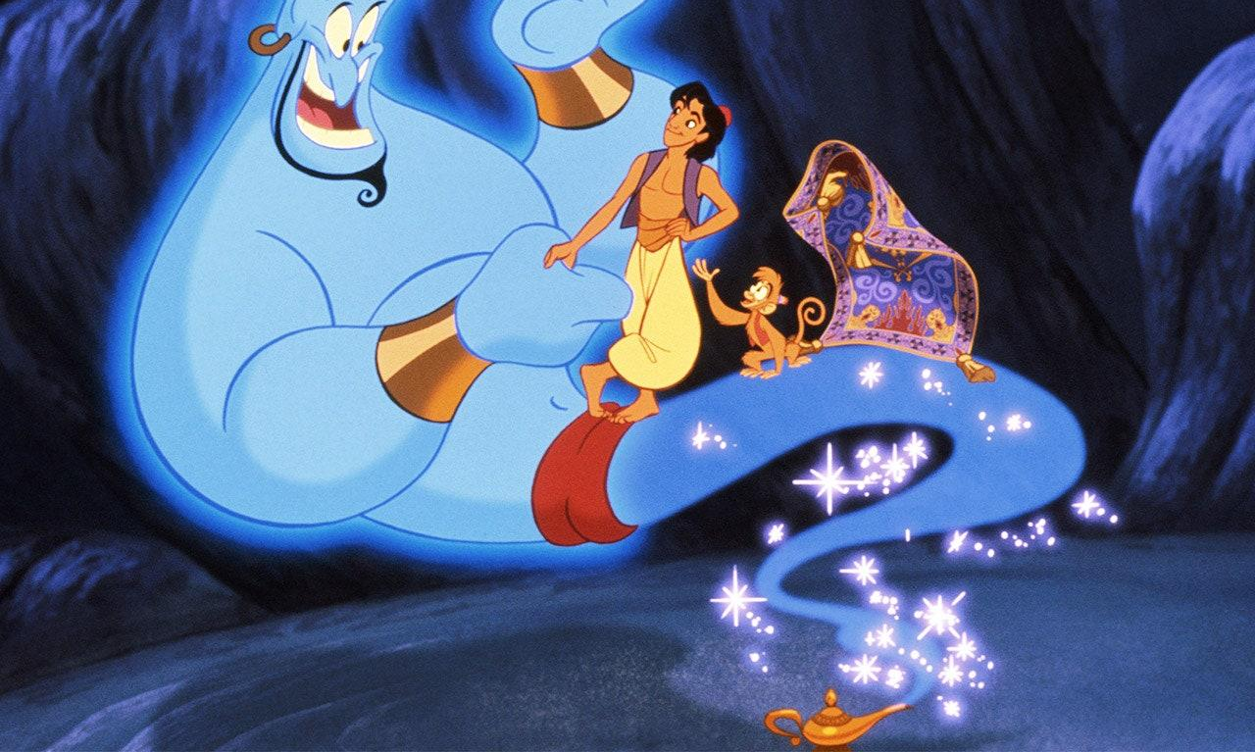
Genie was stuck in the lamp for how many years before Aladdin found him?
Genie was stuck in the lamp for how many years before Aladdin found him?
A. 10,000 Hours
B. 100,000 years
C. 100 Years
D. 10,000 Years

Slide 51
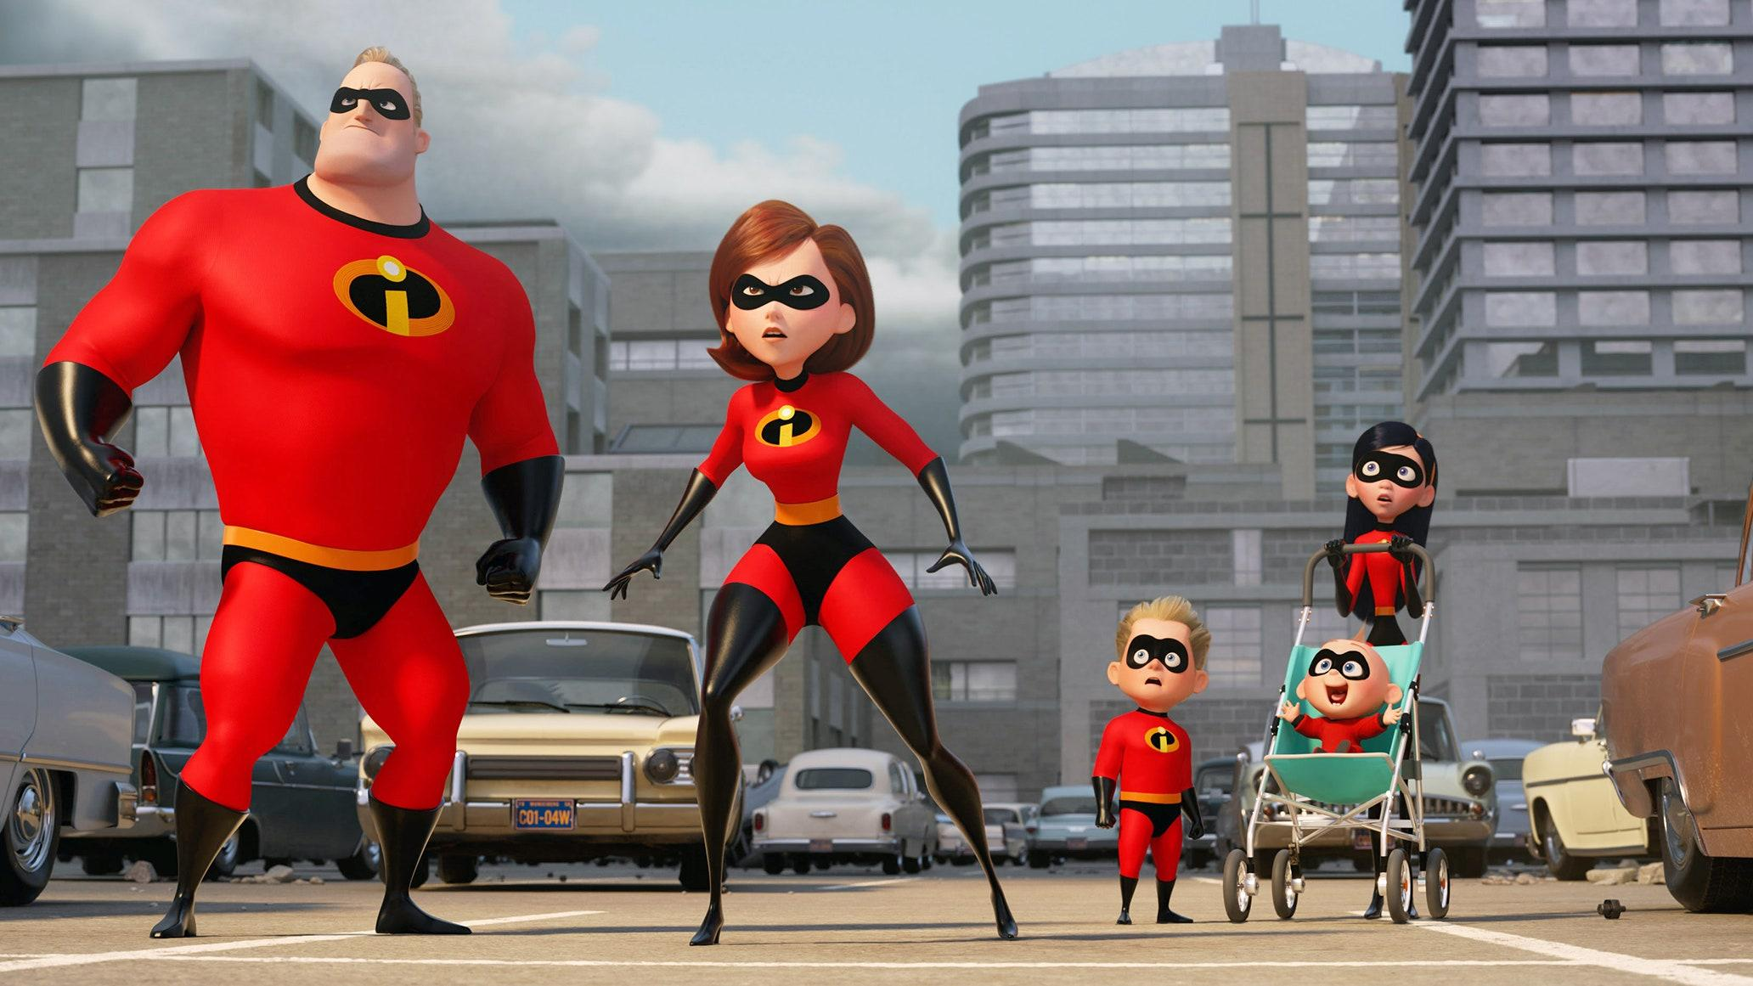
Who is the fashion designer in The Incredibles?
Who is the fashion designer in The Incredibles?
A. Elastigirl
B. Violet Parr
C. Edna Mode
D. Syndrome

Slide 52
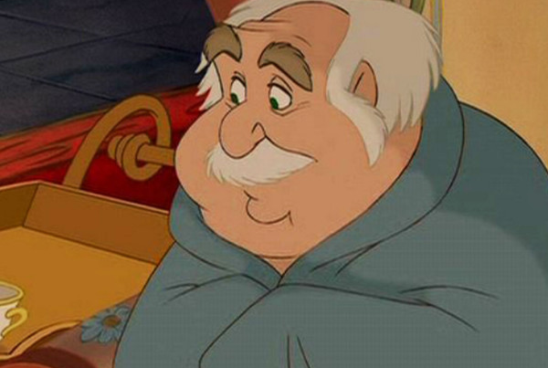
What is the name of Belle’s father in Beauty and the Beast?
What is the name of Belle’s father in Beauty and the Beast?
A. Maurice
B. Morris
C. Phillip
D. Marques

Slide 53
What was the first Pixar movie?
What was the first Pixar movie?
A. Cars
B. Toy Story
C. Monster’s, INC
D. Incredibles

Slide 54
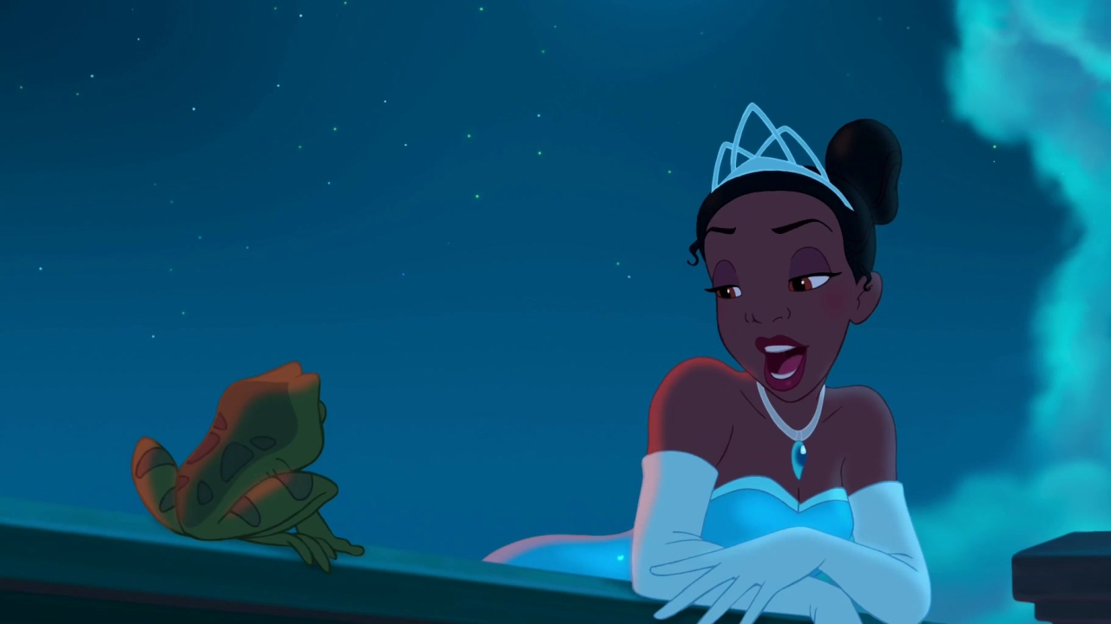
The Princess and the Frog is set in which city?
The Princess and the Frog is set in which city?
A. New Orleans
B. NEw York
C. Chicago
D. San fransokyo

Slide 55
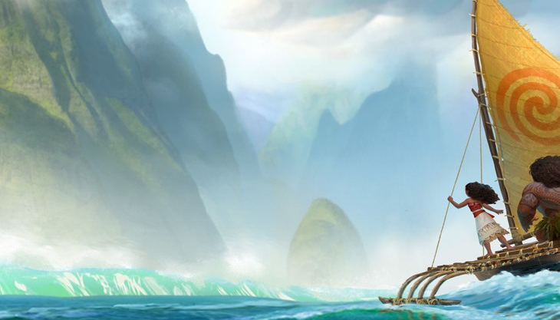
Which Disney character sings “How Far I’ll Go”?
Which Disney character sings “How Far I’ll Go”?
A. Elsa
B. Gaston
C. Rapunzel
D. Moana

Slide 56
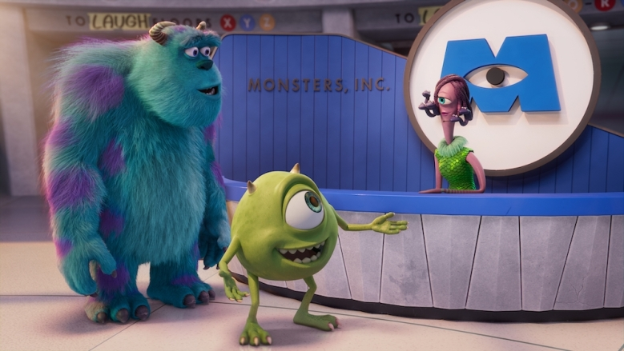
In Monster’s, Inc., there’s nothing more toxic or deadly than what?
In Monster’s, Inc., there’s nothing more toxic or deadly than what?
A. A Human Child
B. Nuclear Waste
C. Nightmares
D. Monsters

Slide 57
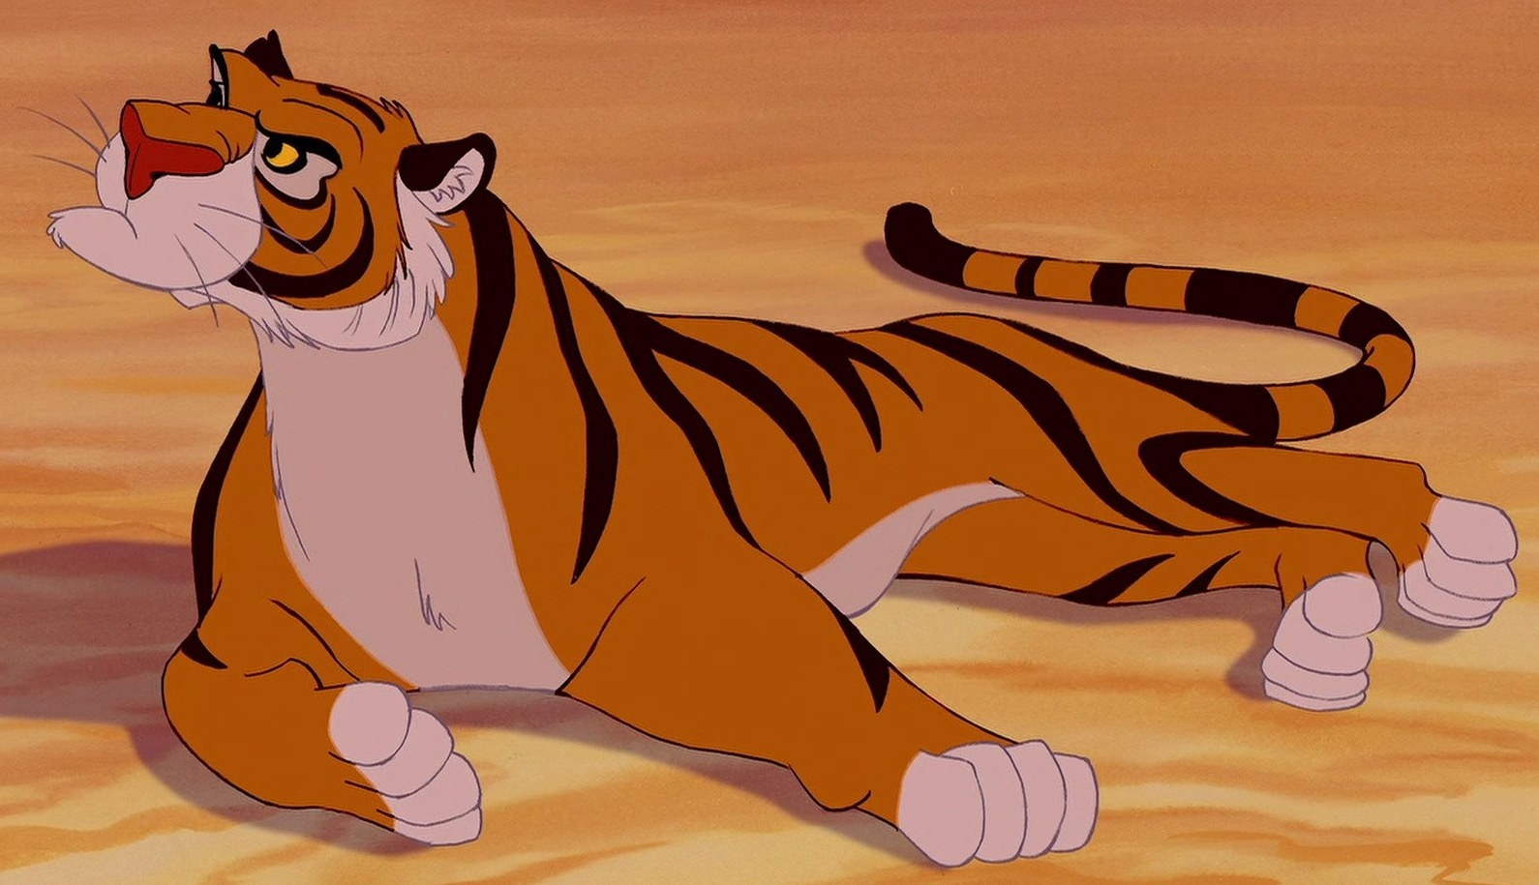
Princess Jasmine’s tiger is named what?
Princess Jasmine’s tiger is named what?
A. Pi
B. Abu
C. Iago
D. Rajah

Slide 58
What is the name of Pixar’s lamp mascot?
What is the name of Pixar’s lamp mascot?
A. Lampy
B. Lumo Jr.
C. Luxo Sr.
D. Luxo Jr.

Slide 59
THE JOURNEY TO A BRIGHTER FUTURE WILL NOT BE POSSIBLE WITHOUT YOUR SUPPORT!
THE JOURNEY TO A BRIGHTER FUTURE WILL NOT BE POSSIBLE WITHOUT YOUR SUPPORT!

Slide 60
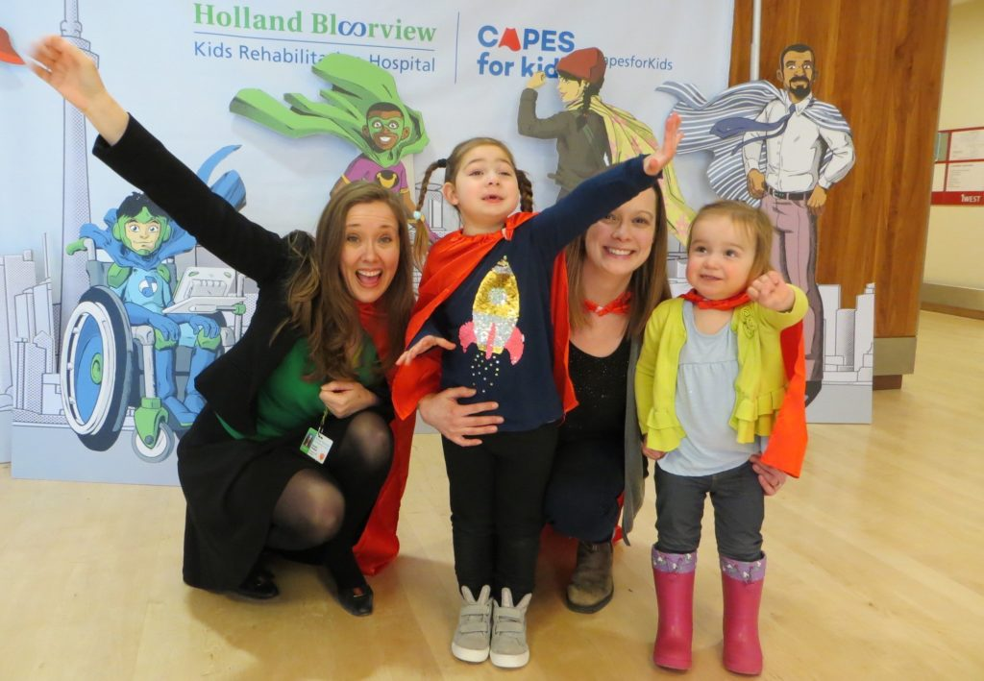
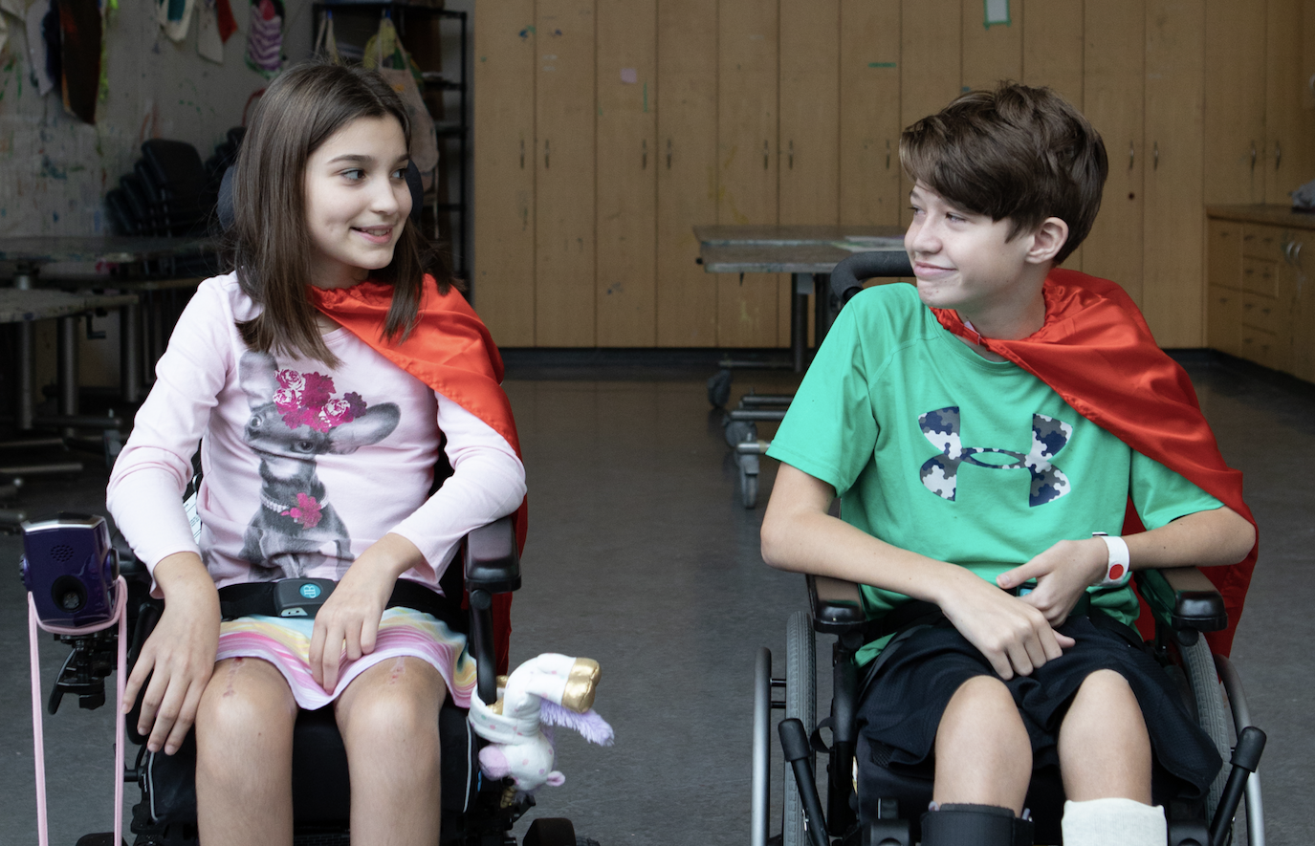
Resources
Resources
Click here if you would like to download some super cool, social graphics! These include Facebook, Twitter, LinkedIn, and email banners, zoom backgrounds and template posts.
Click here if you would like to watch Holland Bloorview’s impact video for Capes for Kids!
Click here to read Holland Bloorview’s Impact Stories!

Slide 61
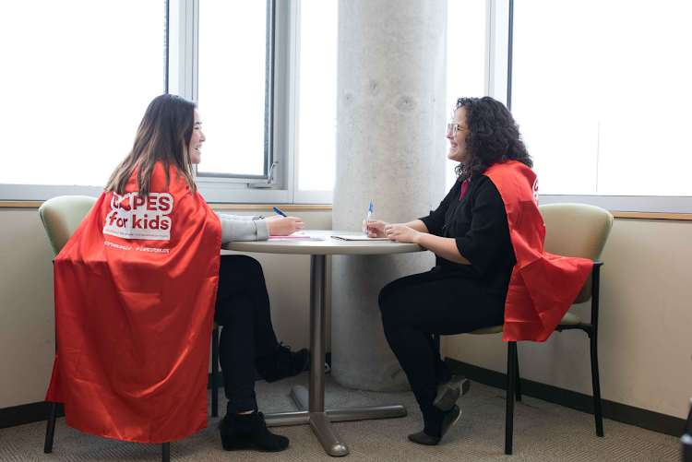
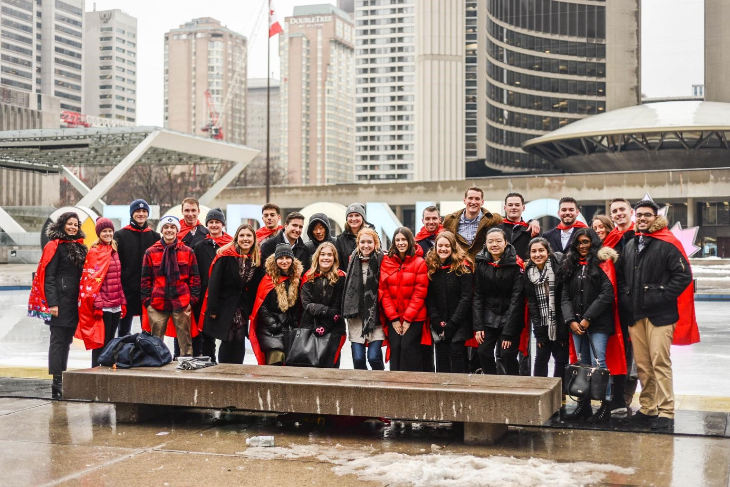
FAQs
FAQs
WHAT IS CAPES FOR KIDS?
Capes for Kids is a fun, family friendly event where we encourage everyone to wear their cape and raise money to support kids with disabilities at Holland Bloorview Kids Rehabilitation Hospital. Register online, set a fundraising goal and decide what your action will be and then start fundraising! Wear your cape during Capes Week!
HOW DO I REGISTER?
You may register as an individual, create your own fundraising team or join an existing fundraising team. Registration takes 5 minutes, and when you’re done, you’ll have your own personal fundraising page and link that you can send to your network and community.

Slide 62
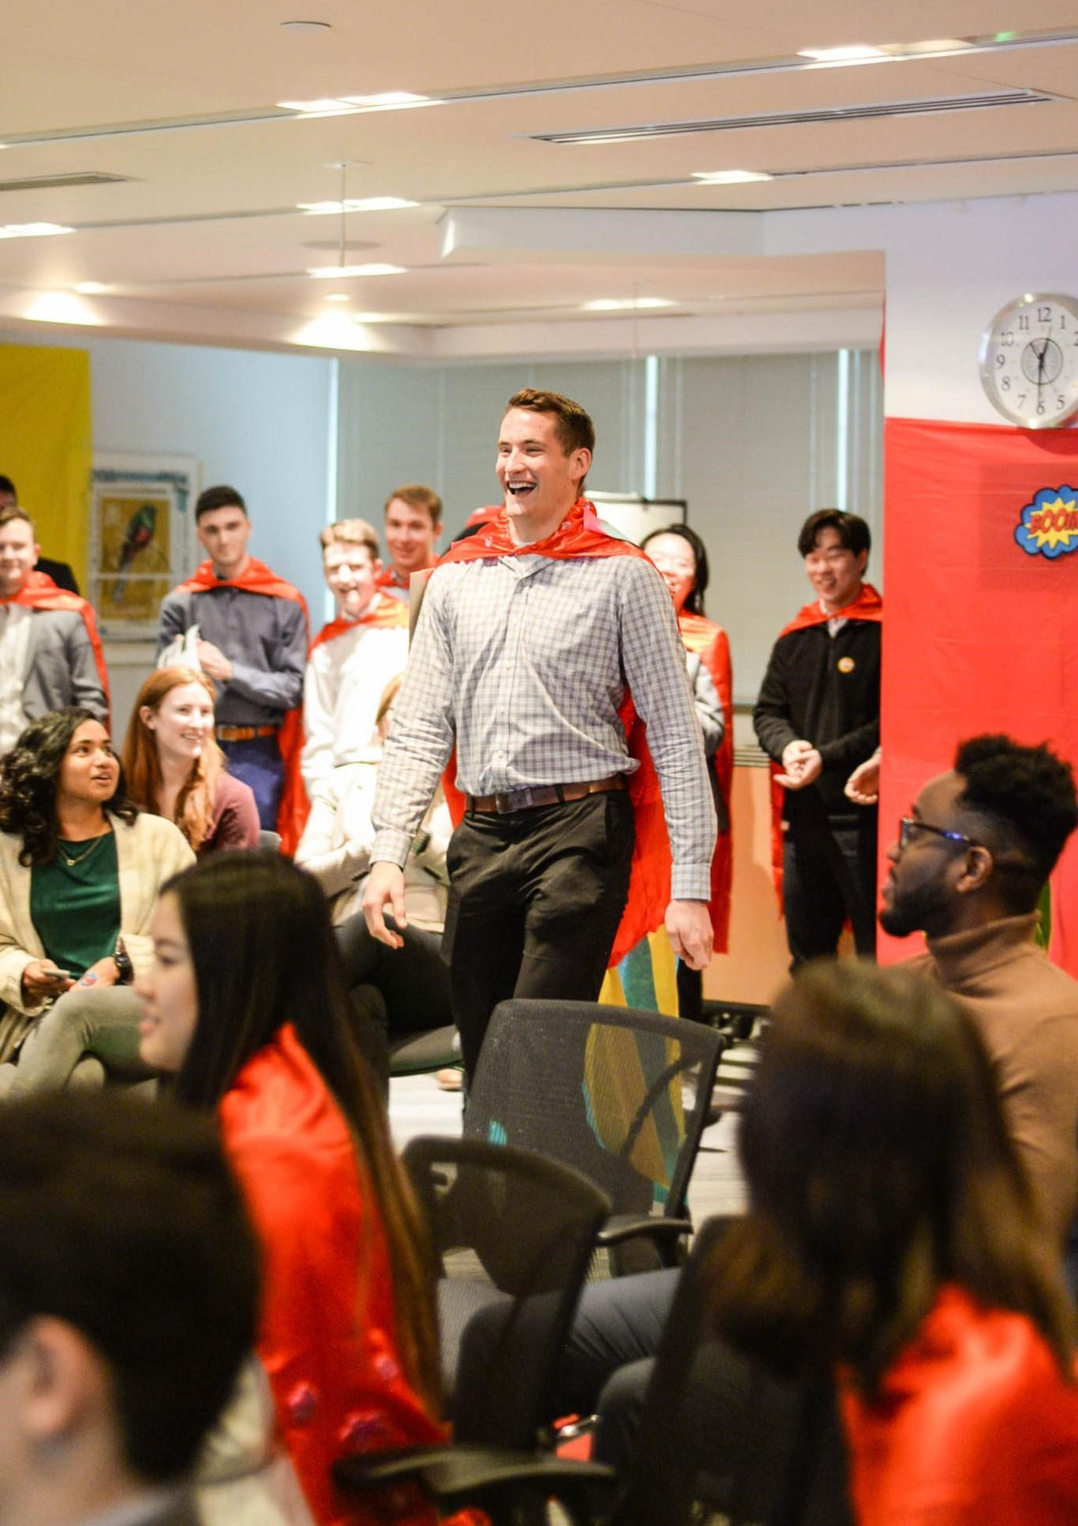
FAQs
FAQs
DO I HAVE TO RAISE A MINIMUM
AMOUNT TO PARTICIPATE?
No. There is no fundraising minimum. But you’d be surprised how people will support you when they understand why you’re wearing a cape, and where their money will go.
HOW WILL THE DONATIONS BE USED?
All money raised through Capes for Kids supports Holland Bloorview’s innovative programs and services and cutting-edge research that help kids with disabilities move, speak, play, learn and grow.

Slide 63
Capes COntact Info
Capes COntact Info
Have a question or want to learn more about Capes for Kids? We’d love to hear from you.
Holland Bloorview Kids Rehabilitation Hospital Foundation
150 Kilgour Road
Toronto, Ontario
M4G 1R8
Telephone: 416-564-8817
Toll Free: 1-800-490-7940
Fax: 416-425-4531
Email: capesforkids@hollandbloorview.ca
Charitable Business Number: 88932-6278-RR0001

